Slide 1
Evaluating HPC Scheduling Strategies for Urgent Workloads
Nov 21, 2025, WIUHPC Workshop at SC25
Ketan Maheshwari, Anderson Borch (Colorado State Univ), Jordan Webb, Brian Etz, Ross Miller, Frederic Suter, Sarp Oral, Rafael Ferreira da Silva
Oak Ridge National Laboratory

Slide 2
Overview
A study and analysis of responsiveness, (un)fairness, user-experience and system utilization in an HPC job scheduling environment where a fraction of jobs have requirements for urgent computing.
Code and other artefacts at: github.com/ketancmaheshwari/wiuhpc25

Slide 3
Context
DOE’s IRI has a vision to accommodate applications with diverse urgency requirements within a unified job scheduling environment
Present work is an attempt to analyze such a scenario and quantify various outcomes

Slide 4
Contributions
A comparative evaluation of four widely used job scheduling simulators, identifying their capabilities and critical limitations for modeling urgent and mixed-urgency HPC workloads.
The design and implementation of an emulation-based methodology that operates on a real Slurm cluster, enabling reproducible experiments with realistic user submission patterns, urgency levels, and QoS policies.
A suite of nine experimental scenarios that systematically explore combinations of QoS configurations, preemption strategies, requeueing options, and workload characteristics, allowing detailed analysis of trade-offs between responsiveness, fairness, and efficiency.
Integration of visual analytics, including aggregated and per-user timelines, cluster utilization trends, and backfilling behavior, to provide actionable insights into how scheduler policies affect both urgent and normal workloads.
A mapping between workload profiles and recommended scheduler configurations, resulting in a practical hybrid scheduling strategy that HPC centers can adapt to balance urgent computing needs with sustained system utilization.

Slide 5
Survey / Evaluation of Job Scheduling Simulators
We begin with looking into the existing job scheduling simulators
Selected 4 representative simulators: Batsim, Accasim, Alea and The Slurm Scheduler

Slide 6
Job Scheduling Simulators: Batsim and Accasim
Batsim:
Accasim:
Notes:
Risk free analysis of systems, Repeatable and reproducible, Fast, Low overhead

Slide 7
Job Scheduling Simulators: Alea and the Slurm scheduler
Alea:
The Slurm scheduler:

Slide 8
Feature gaps in simulators wrt our requirements
No native support for urgent QoS or urgency aware scheduling
Limited or no implementation of job preemption with realistic handling of cancellation or requeuing
Incomplete modeling of dynamic user behavior and event-driven job arrivals
Practical deployment barriers in our testbed environment
Nevertheless, job scheduling simulators are very valuable tools
Notes:
Even with extensive customization, these tools could not fully reproduce the operational conditions of a real HPC scheduler under urgent computing demands. This assessment led us to adopt an emulation-based methodology

Slide 9
The Slurm Simulator: Promising but did not meet our requirements at the time

Slide 10
A Rare Opportunity: “Emulating” Job Scheduling over a real Cluster
OLCF’s Advanced Computing Ecosystem (ACE) testbed

Slide 11
Instrumentation: System and Slurm setup
20 intel nodes with 64 CPUs (2 logical cores/CPU) and 2 Nvidia GPU nodes
Slurm v
Created 20 dummy users

Slide 12
Instrumentation: Experimental Setup
run in sync
for 20 dummy users
invoke MPICatnap* with a
controlled runtime
Tmux session with 22 panes
genjobs script
slurm job
spec
MPICatnap
Generate job spec with randomized
and controlled parameters
control and monitor
* code courtesy: MJ Wilde, ANL/UChicago

Slide 13
Experiments Design: Nine experiments with varying conditions

Slide 14
Experiments Execution

Slide 15
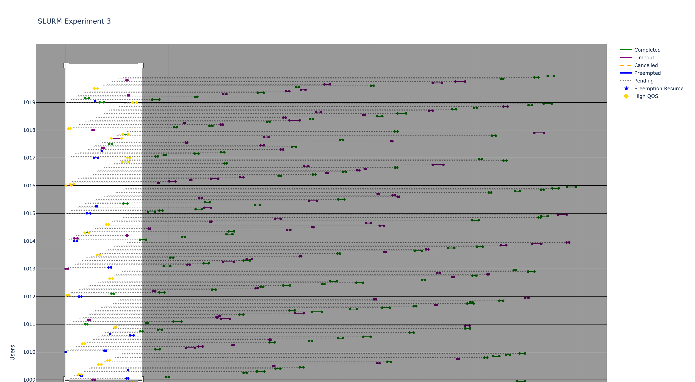
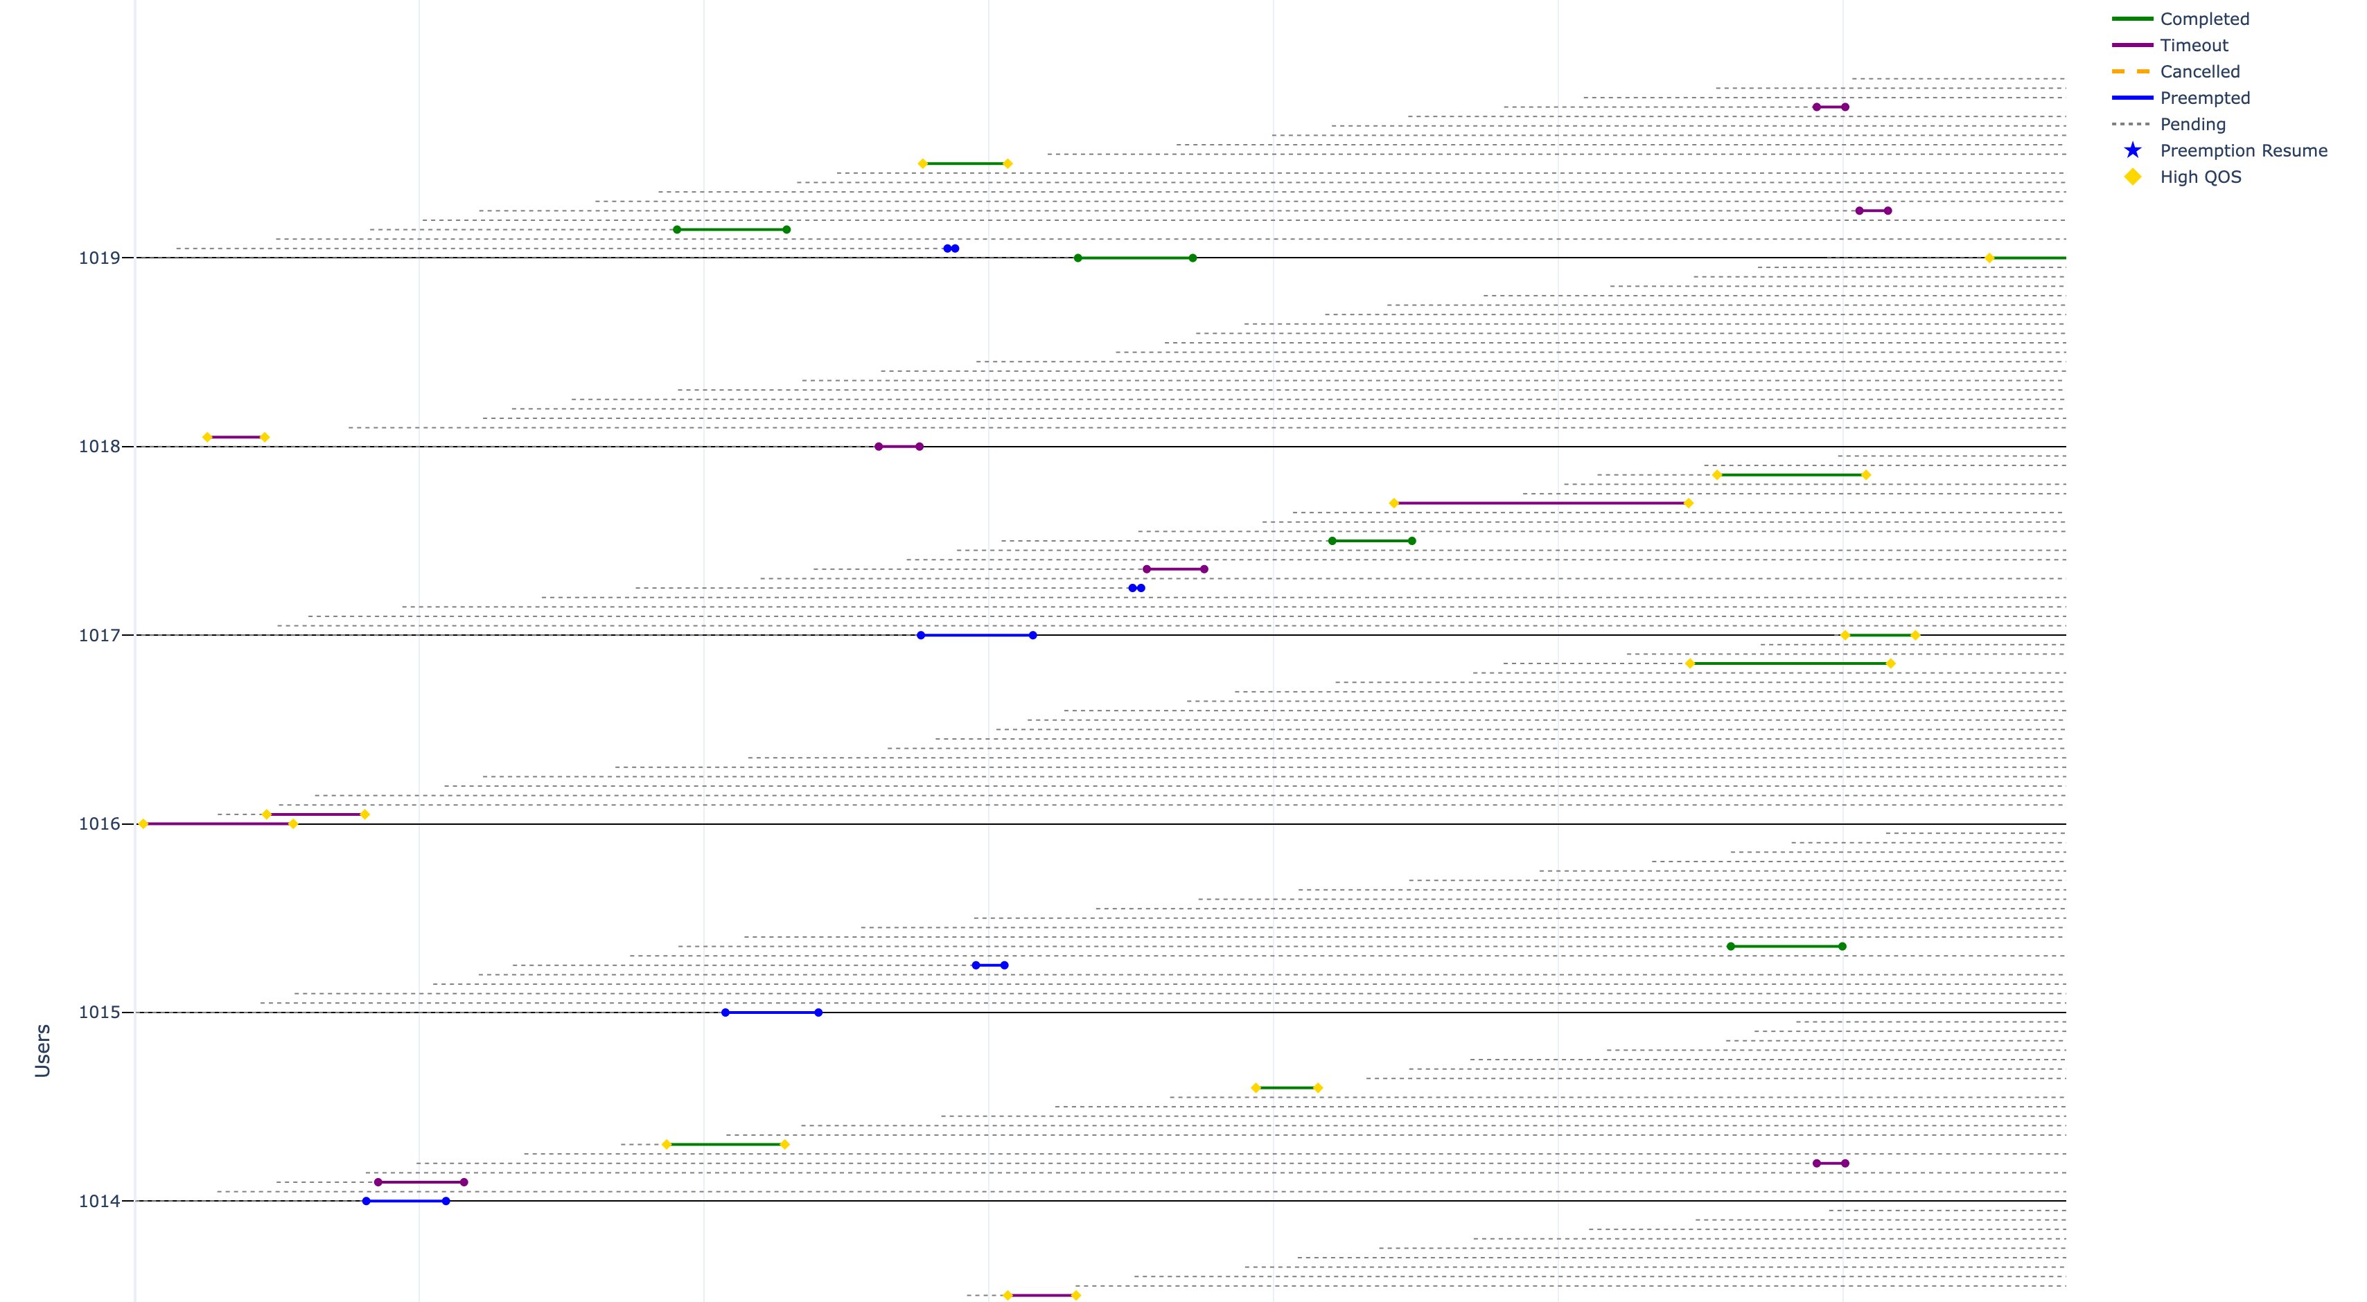
Results Highlights - Swimlane Visualization of jobs by users
Overall View, regions may be selected
for enlargement
Enlarged view

Slide 16
Results Highlights - II

Slide 17
Results Interpretation

Slide 18
Conclusion and Future Work
An emulator for job scheduling emulating tunable and real-world job scenarios
We use existing scheduling features, but plugins may be developed to achieve desired goals
Alea -> AleaNG addressing the limitations of simulators and possible enabling many more experimental scenarios

Slide 19
Acknowledgements
This research used resources of the OLCF at ORNL, which is supported by DOE’s Office of Science under Contract No. DE-AC05-00OR22725.

Slide 20
Thank You for your time! Questions?
km0@ornl.gov | https://github.com/ketancmaheshwari/wiuhpc25

Slide 21
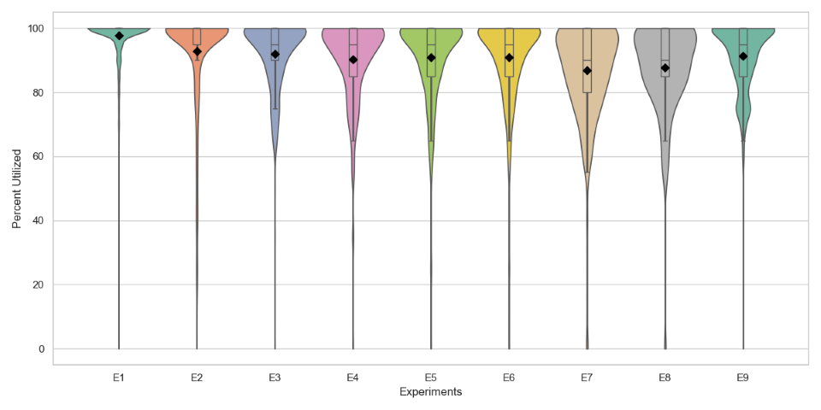
Extra Slide: Violin plot for system utilization without the extrapolation

